Slide 1

Sampah images

Slide 2
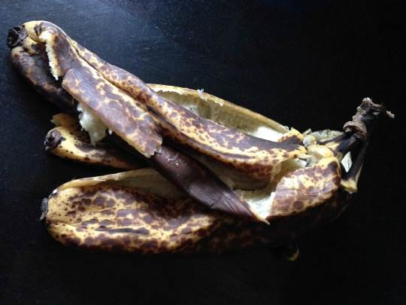
Banana peel

Slide 3
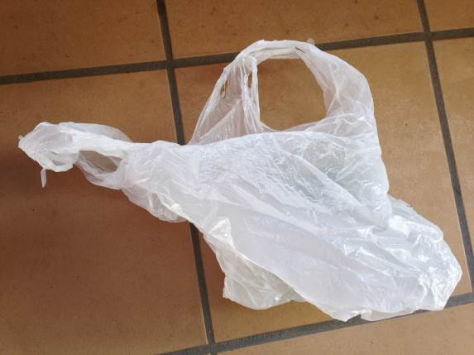
Plastic bag

Slide 4
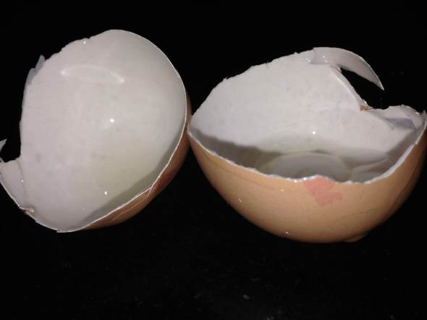
Broken egg shell

Slide 5
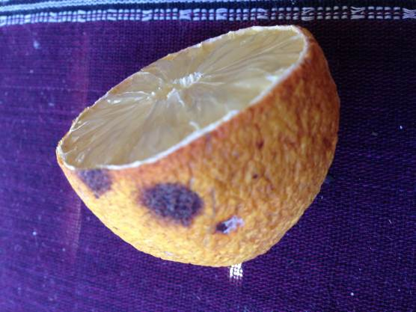
Rotting lemon

Slide 6
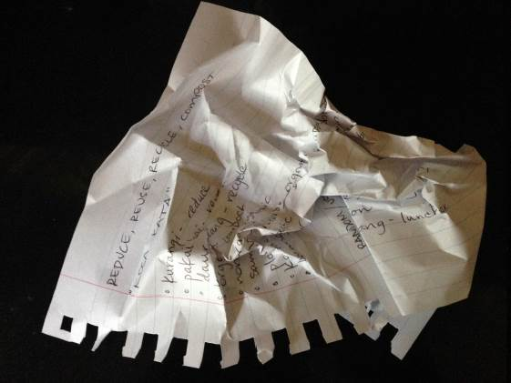
Scrunched up paper

Slide 7
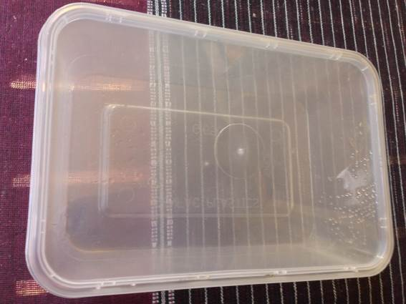
Plastic container

Slide 8
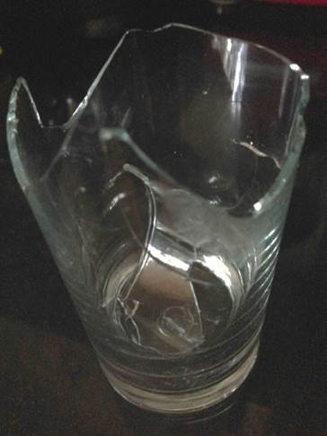
Broken drinking glass

Slide 9
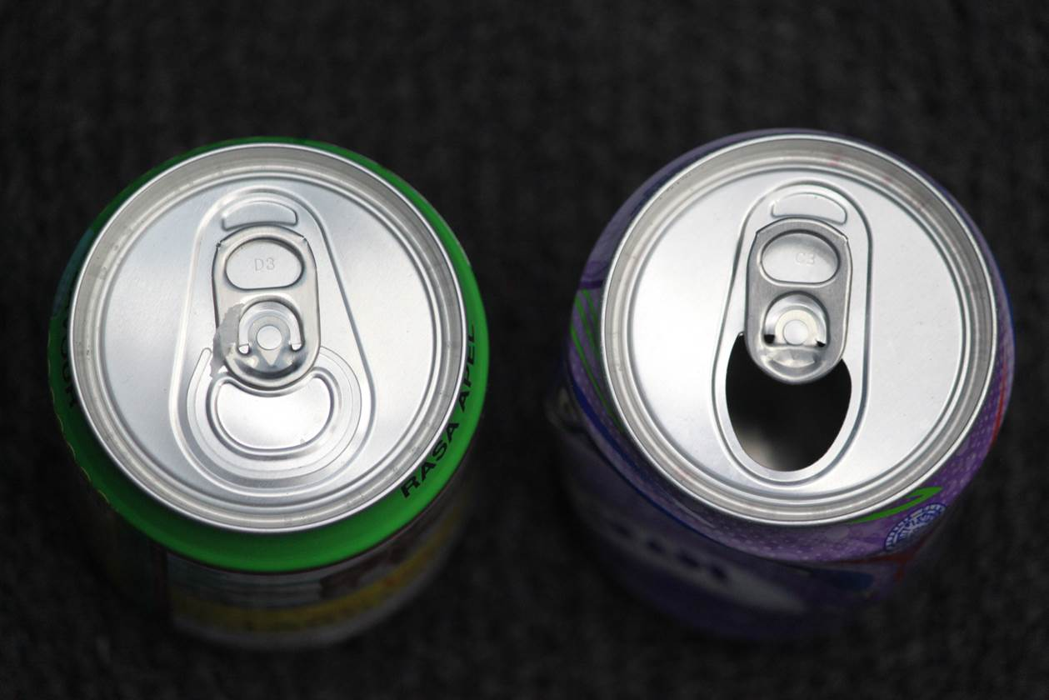
Two cans of soft drink

Slide 10
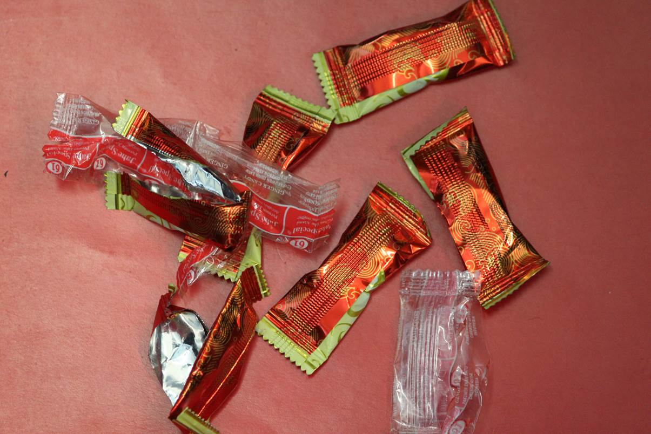
Indonesian sweet wrappers

Slide 11
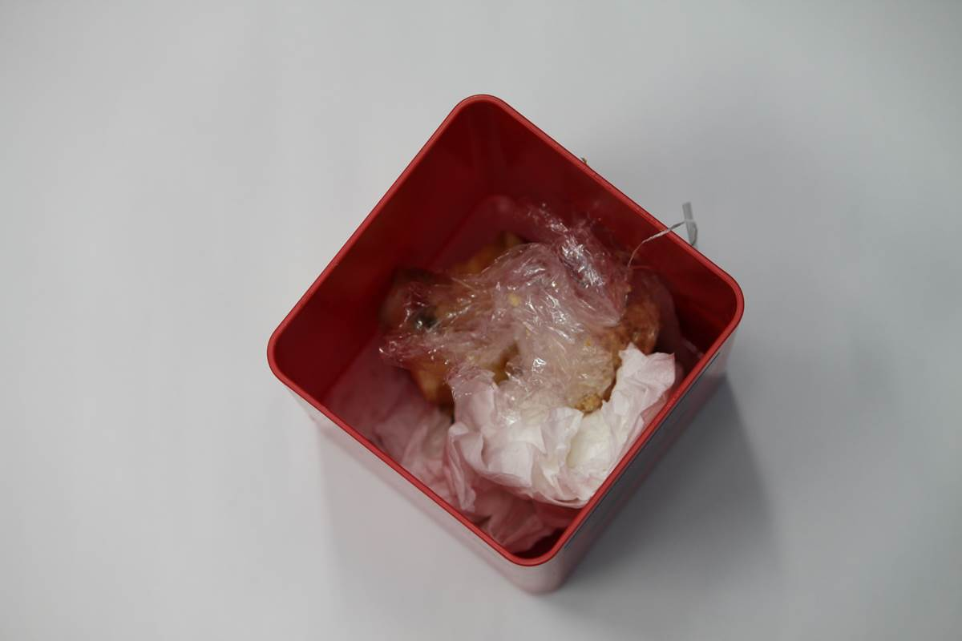
Recycling bin with waste in it

Slide 12
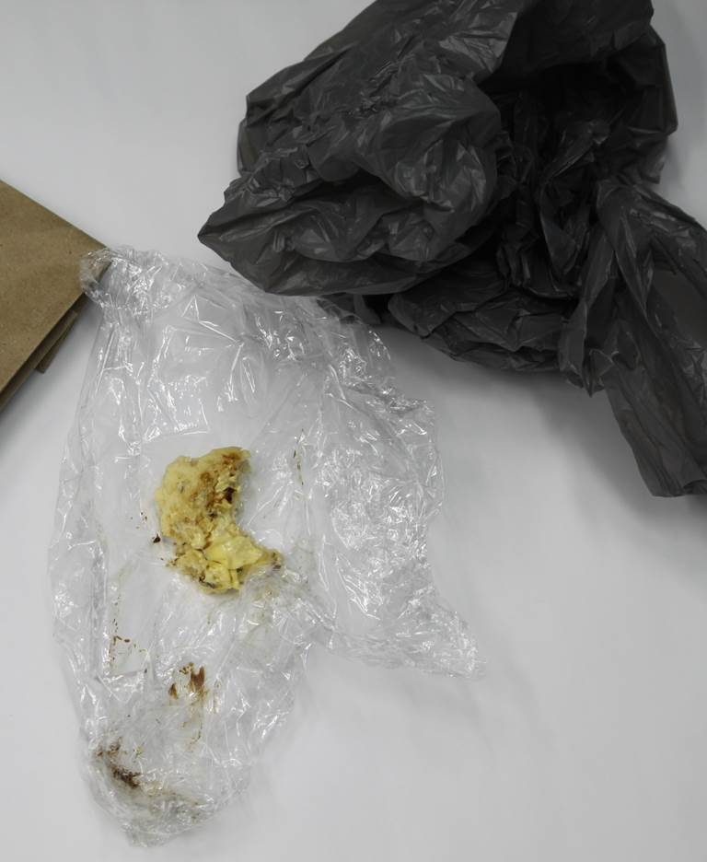
Old food on plastic wrap

Slide 13
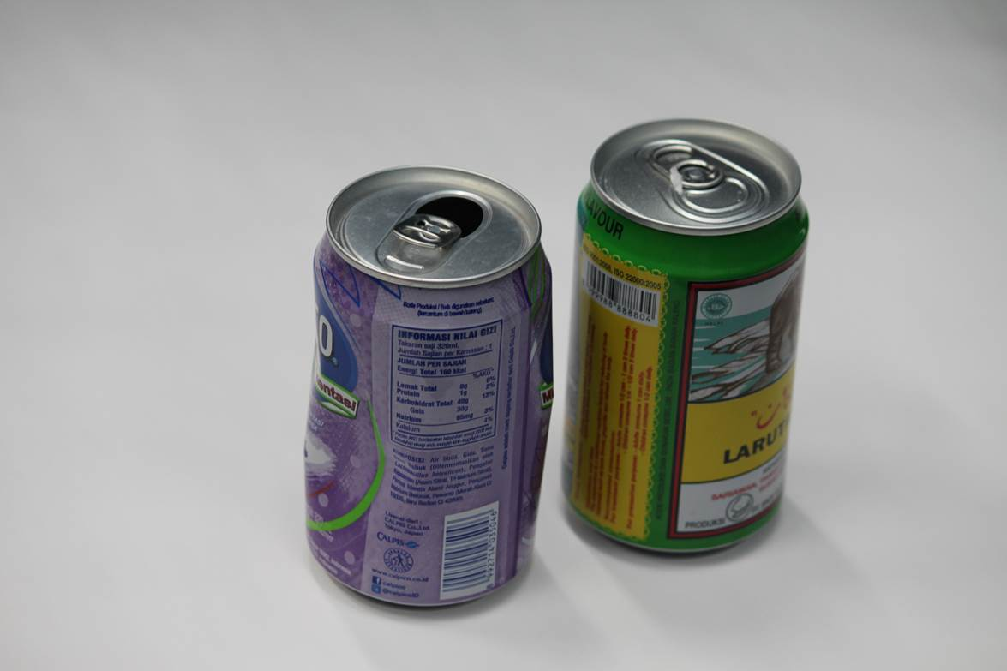
Two cans of Indonesian soft drinks

Slide 14
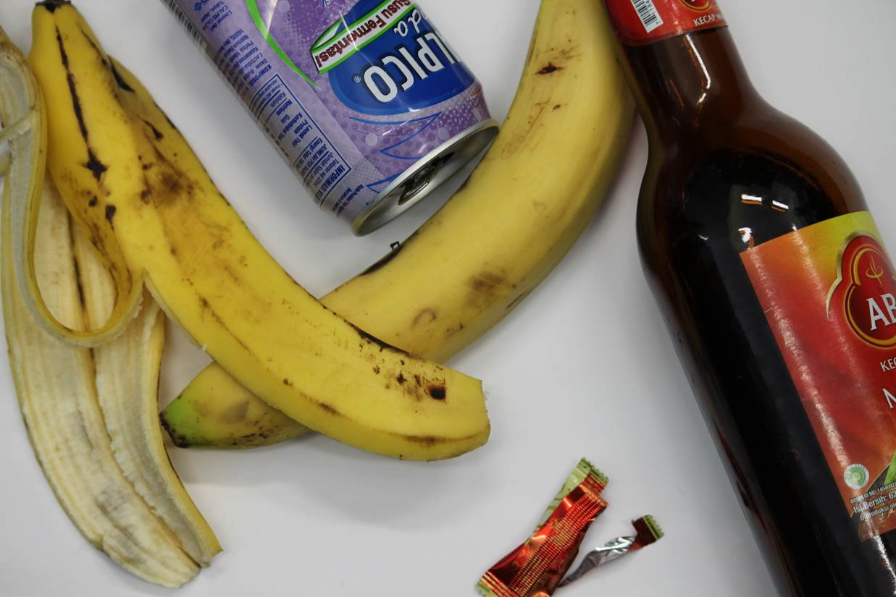
Rubbish

Slide 15
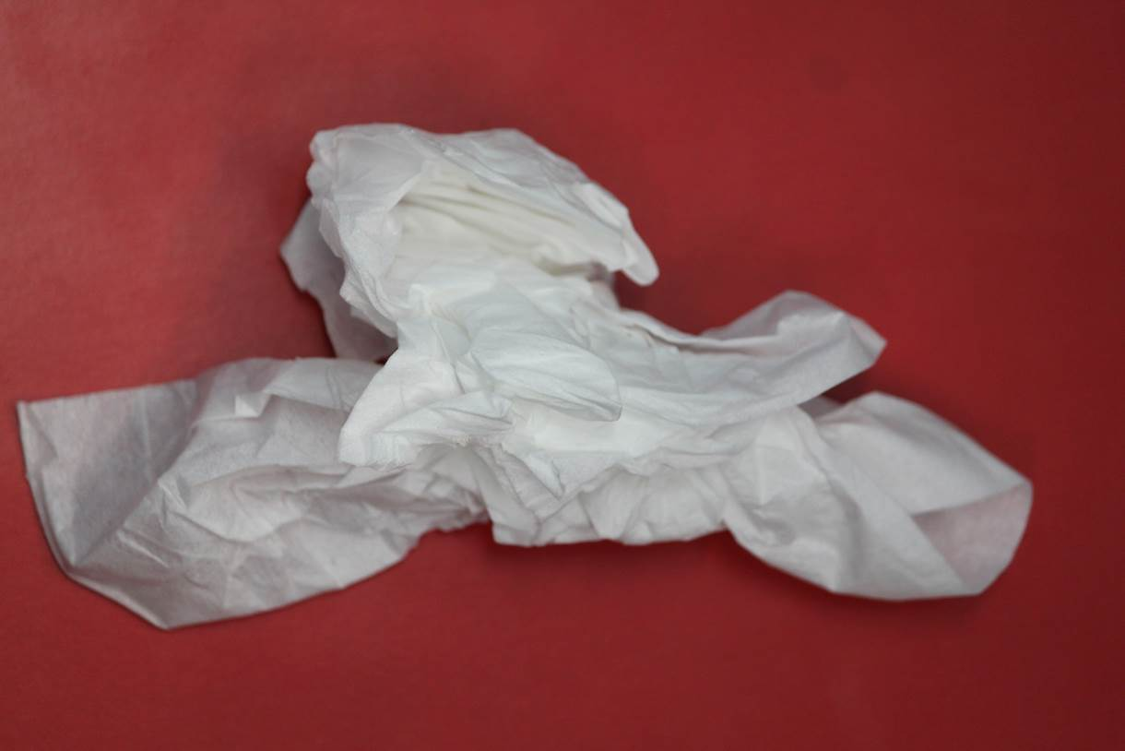
Scrunched tissues

Slide 16


